Slide 1
Chapter 8
How are Software Packages Developed?

Slide 2
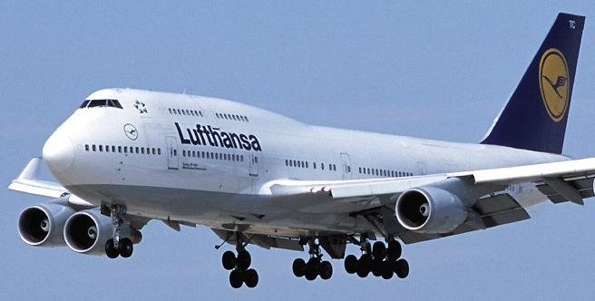
Complex

Slide 3
747
4,500 people
40 hours per week
4 weeks per month
28 months
20,160,000 person hours

Slide 4
Red Hat Linux 7.1
30 million SLOC
8,000 person years
2,000 hours per year
16,000,000 person hours

Slide 5
Linux Kernels
Year Operating System SLOC (Million)
2000 Debian 2.2 55–59
2002 Debian 3.0 104
2005 Debian 3.1 215
2007 Debian 4.0 283
2009 Debian 5.0 324
2012 Debian 7.0 419
Notes:
http://en.wikipedia.org/wiki/Source_lines_of_code

Slide 6
Windows
Year Operating System SLOC (Million)
1993 Windows NT 3.1 4-5
1994 Windows NT 3.5 7-8
1996 Windows NT 4.0 11-12
2000 Windows 2000 >29
2001 Windows XP 45
2003 Windows Server 2003 50

Slide 7
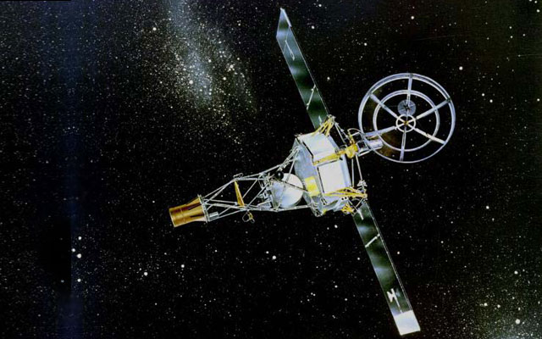
What’s the Problem?

Slide 8
What’s the Problem?
Mariner 1
“The most consistent account was that the error was in hand-transcription of a mathematical symbol in the program specification, in particular a missing overbar.”
Notes:
http://en.wikipedia.org/wiki/Mariner_1

Slide 9
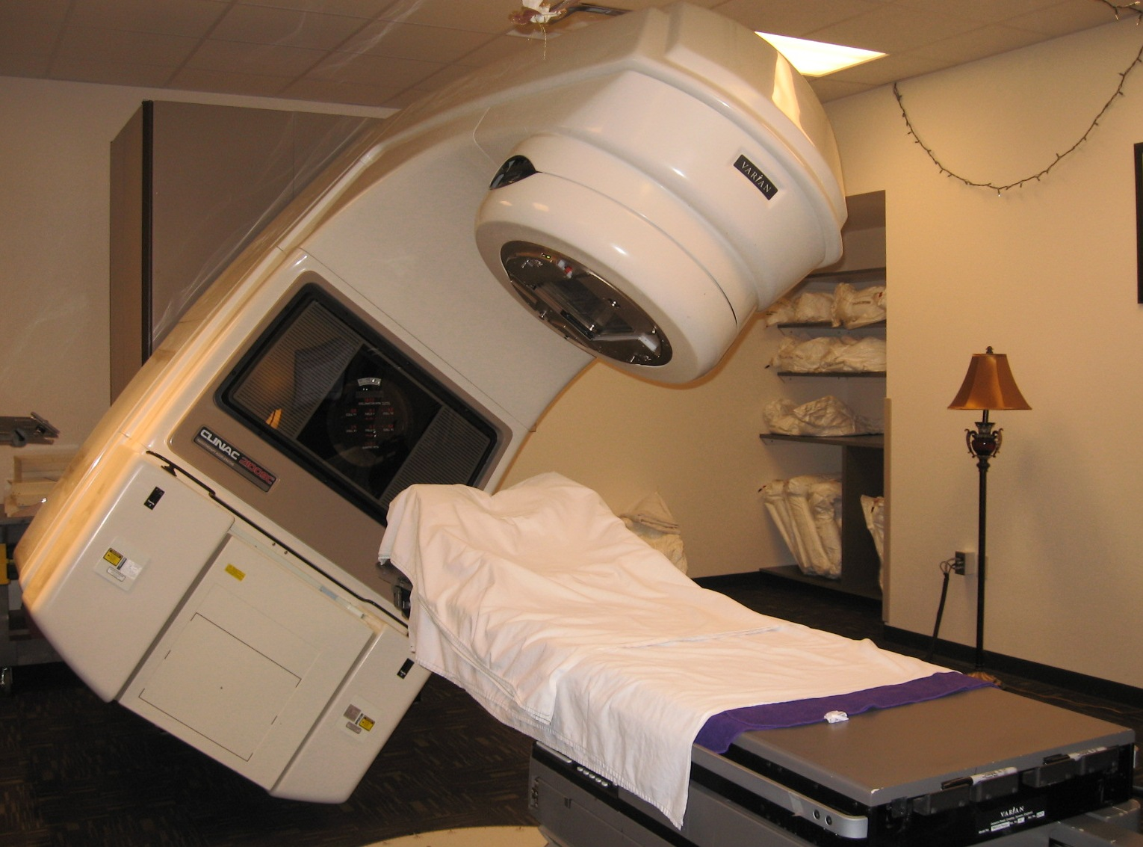
What’s the Problem?

Slide 10
What’s the Problem?
Therac 25
“It was involved in at least six accidents between 1985 and 1987, in which patients were given massive overdoses of radiation, approximately 100 times the intended dose.”
"in three cases, the injured patients later died as a result of the overdose."
Notes:
http://en.wikipedia.org/wiki/Therac-25

Slide 11
What’s the Problem?
“A commission concluded that the primary reason should be attributed to the bad software design and development practices, and not explicitly to several coding errors that were found. In particular, the software was designed so that it was realistically impossible to test it in a clean automated way.”

Slide 12
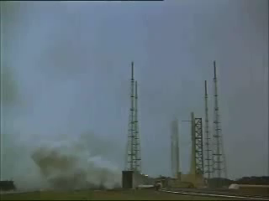
What’s the Problem?

Slide 13
What’s the Problem?
Ariane 5
“A data conversion from 64-bit floating point value to 16-bit signed integer value to be stored in a variable representing horizontal bias caused a processor trap (operand error) because the floating point value was too large to be represented by a 16-bit signed integer.”
Notes:
http://en.wikipedia.org/wiki/Ariane_5

Slide 14
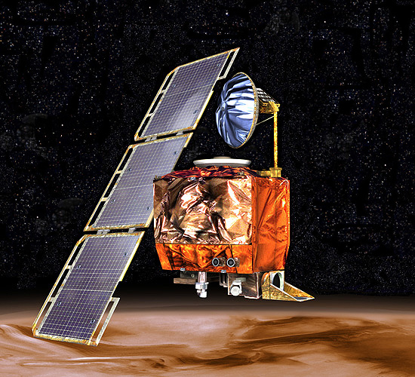
What’s the Problem?

Slide 15
What’s the Problem?
Mars Climate Orbiter
“…due to ground-based computer software which produced output in non-SI units of pound-seconds (lbf×s) instead of the metric units of newton-seconds (N×s) specified in the contract between NASA and Lockheed.”
Notes:
http://en.wikipedia.org/wiki/Mars_Climate_Orbiter

Slide 16
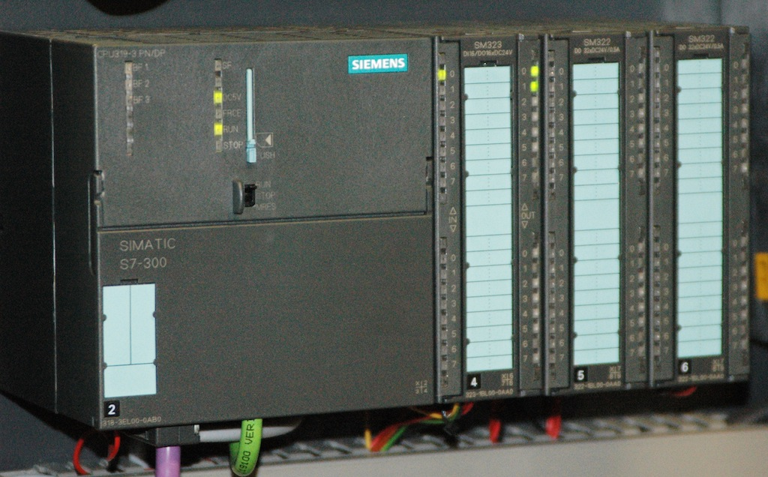
What’s the Problem?

Slide 17
What’s the Problem?
“Stuxnet is a computer worm discovered in June 2010 that is believed to have been created by United States and Israeli agencies to attack Iran's nuclear facilities. Stuxnet initially spreads via Microsoft Windows, and targets Siemens industrial control systems.”
Notes:
http://en.wikipedia.org/wiki/Stuxnet

Slide 18
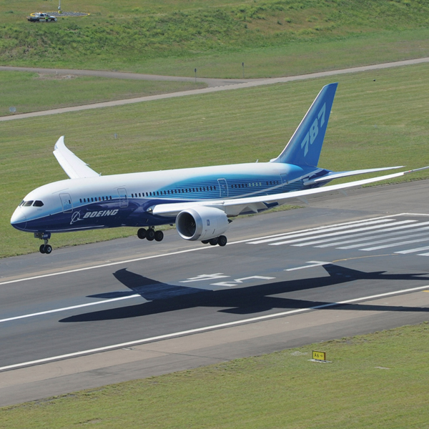
What’s the Problem?

Slide 19
What’s the Problem?
According to the FAA, there's a software bug in the 787 Dreamliner that can cause its electrical system to fail and, as a result, lead to "loss of control" of the plane
248 days = 2³¹ 100ths of a second
Even in 2015, our airplanes have integer overflow bugs
Notes:
http://www.engadget.com/2015/05/01/boeing-787-dreamliner-software-bug/
@FioraAeterna

Slide 20
Steps
Describe the problem to be solved
Example
Large fields have different soils in different parts
Farmers take samples to find what each part needs
Want to change delivery of fertilizers from part to part
Too complicated for farmer

Slide 21
Steps
Solution
Use GPS and computer-control application
Saves fertilizer
Doesn’t burn crops
Doesn’t add to ground water pollution
Requires both hardware and software

Slide 22
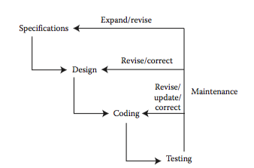
Generic

Slide 23
Historical
Requirement gathering
Specifications
Design
Coding
Test
Release
Maintenance

Slide 24
Specifications
Careful statement of what problem(s) need to be solved
Difficult
Specifications can be vague, conflicting
Current users might not know what is possible
Might like current solution
If something is truly new, how do we specify?

Slide 25
Specifications
Can take a lot of work
Traffic lights
Seems simple: Green/Yellow/Red
But for a large city, must be coordinated to keep traffic flowing
What do we optimize? Throughput? Wait time? Public transportation?
Emergency vehicle traffic

Slide 26
Specifications
These are how we measure success
Test to assure specifications met
Direct bearing on customer satisfaction

Slide 27
Architecture and Design
What algorithms do we use?
How are they combined?
How do the communicate?
What are the data needed?
What is their format?
Input and output
Baking pie: recipe and materials

Slide 28
Architecture and Design
Must be a reasonable solution
One approach to know tomorrow’s weather is wait until the day after tomorrow
Timely
Affordable
Appropriate

Slide 29
Coding
Aka programming
Writing algorithms, typically in a high-level language
Language translated into primitive instructions
Might be compiled or interpreted

Slide 30
Bugs
A “nice” name for errors or mistakes
Term used by Thomas Edison in 1878
Testing helps expose bugs
Usually several layers of testing
Debugging process of removing errors

Slide 31
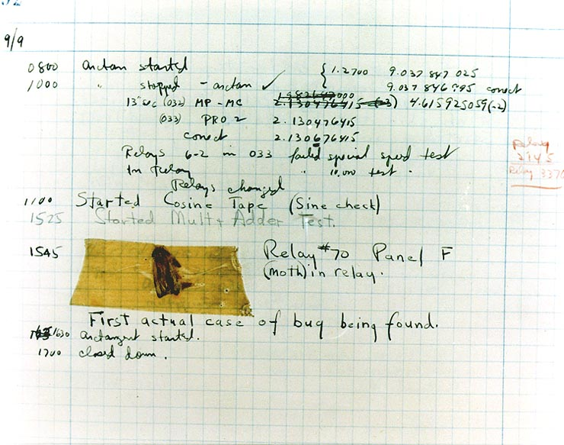
Bug (Moth)

Slide 32
Maintaining Programs
Many changes occur during software’s lifetime
Platform
Laws
Improvements
Fixes
Maintenance often longer and more expensive than development

Slide 33
Percentages
Specifications: 20%
Design: 30%
Coding: 30%
Testing: 20%

Slide 34
Programming Language
X = 3 + 5
Load 5 into register
Load 3 into register
Add in the CPU
Store result in register
Lowest level close to 1’s and 0’s
Assembly or machine language

Slide 35
Simple C Program
#include <stdio.h>
int main (int argc, char **argv)
{
int x;
x = 3 + 5;
printf ("%d\n", x);
}

Slide 36
Assembly
.section __TEXT,__text,regular,pure_instructions
.macosx_version_min 10, 10
.globl _main
.align 4, 0x90
_main: ## @main
.cfi_startproc
## BB#0:
pushq %rbp
Ltmp0:
.cfi_def_cfa_offset 16
Ltmp1:
.cfi_offset %rbp, -16
movq %rsp, %rbp

Slide 37
Assembly
Ltmp2:
.cfi_def_cfa_register %rbp
subq $32, %rsp
leaq L_.str(%rip), %rax
movl %edi, -4(%rbp)
movq %rsi, -16(%rbp)
movl $8, -20(%rbp)
movl -20(%rbp), %esi
movq %rax, %rdi
movb $0, %al
callq _printf

Slide 38
Assembly
xorl %esi, %esi
movl %eax, -24(%rbp) ## 4-byte Spill
movl %esi, %eax
addq $32, %rsp
popq %rbp
retq
.cfi_endproc
.section __TEXT,__cstring,cstring_literalsL_.str: ## @.str
.asciz "%d\n”
.subsections_via_symbols

Slide 39
Language Generations
First: machine
Second: assembly
Third: C, Pascal
Fourth: GUI builder, Mathematica, DB managers
Domain Specific Languages

Slide 40
Aspects
Syntax
What is allowed and not allowed
Grammar
Semantics
What is meant

Slide 41
Types
Imperative
Most widely used
Object Oriented
Ruby, Smalltalk
Logic
Prolog
Functional
LISP, Clojure, Scheme

Slide 42
Types
Concurrent
Erlang
Visual
Scratch, Snap

Slide 43
Five Widely Used
Java: for large and complex problems; web applications
C: scientific, operating systems, embedded
C++: somewhere between C and Java (historically, C first, then C++, then Java)
BASIC: for learning how to program
PHP: web

Slide 44
Determining User Needs
Market analysis
Observe people doing work and automate tasks
Users only know their own needs
“Inside the box”

Slide 45
Determining User Needs
Word processing
Paper and pencil; users don’t know what’s possible
Publishers want markup; usual user doesn’t need
“Prediction is very difficult, especially if it's about the future” -- Niels Bohr
Twitter, Snapchat, YikYak, etc.

Slide 46
Prototypes
A somewhat functional application
Get it into users’ hands
Ask what they like and don’t like
A small start that can be expanded
Inexpensive
Can iterate to create final solution
Iteration never complete

Slide 47
Approaches
Waterfall
Agile
Open source

Slide 48
Waterfall
Based on other types of engineering
Each phase done in turns
Each complete before next phase
Requirements, architect, design, code, test, release
Known schedule

Slide 49
Downsides
Things change
Schedule affected
No feedback until the end

Slide 50
Agile
Do steps repeatedly
Release often
Continuous deployment
Accept changes
Early feedback
Early introduction to marketplace
Extreme programming
Scrum

Slide 51
Agile Manifesto
Individuals and interactions over processes and tools
Working software over comprehensive documentation
Customer collaboration over contract negotiation
Responding to change over following a plan
Notes:
http://www.agilemanifesto.org/

Slide 52
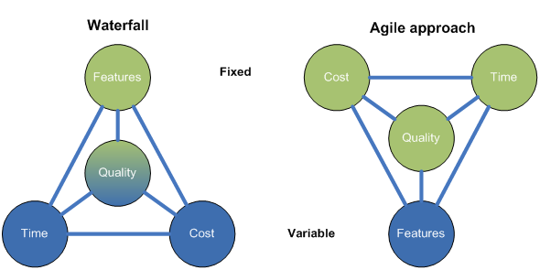
Quality (reality) triangle

Slide 53
Why Are There So Many Features?
Not all users want the same thing
Some are more sophisticated than others
Features sell software
Well, and everything else
Features may become more important over time

Slide 54
Updates and Upgrades
It’s now cheap to do
Internet vs. creating media
Fix bugs
Add features
More sales
Upgrades more significant
OS

Slide 55
Updates and Upgrades
Moving to a subscription model
Some number of updates included in price
Version upgrade might cost
Old versions stopped being supported
Moving to ad-based software
Upgrades often contentious
W8, Office bar, etc.

Slide 56
Motivations
Security patches
Other fixes
Better functionality
User needs change
Releases get press
Keep up with competitors

Slide 57
Release Cycles
More often is typically better
New features available sooner
One might delay a month or so for others to find bugs
Don’t upgrade when you really need your computer

Slide 58
Source of Bugs
Not understanding problem
Not understanding code
Not testing all possibilities
There are typically a huge number of possible executions
Interactions in and between programs
Threads, timing attacks

Slide 59
Jobs
Software engineer
Quality Assurance/tester
User interface/experience
Systems analyst

Slide 60
Jobs
Very few solitary programmers
Programs too big
Teamwork has become a primary task
Need excellent communication skills

Slide 61
Types of Software Licenses
Proprietary
You may not modify
You don’t have the source
Free software
You can modify if you allow redistribution
Open source
Free and Open Source Software

Slide 62
Types of Software Licenses
83 types of FOSS licenses on sourceforge
FOSS allows people to examine and contribute
Might help increase quality and security
Level of support and activity varies

Slide 63
Widely Used
Apache
Linux
WordPress
PHP
Firefox
Thunderbird
Audacity
GIMP
Eclipse
Notepad++
MySQL
Libre Office
Etc., etc.

Slide 64
Review
Questions: 1, 3, 4, 5, 6, 9
Exercises: 2, 3, 5, 6, 8, 9
Research: 3, 4, 6

